Slide 1
FEM2401 Malaysian Politics and Society TOPIC 6 : Parliamentary Democracy

Slide 2
OUTLINE :
Democracy and parliamentary democracy
Political Parties in Malaysia
Election in Malaysia
LEARNING OUTCOMES :
To explain the concept of parliamentary democracy
To explain the practice of parliamentary democracy in Malaysia

Slide 3
Who Rules ? What in a name ?
Rule by one : Autocracy
Rule by the few : Oligarchy
Rule by the hereditary king or queen: Monarchy
Rule by by the unsurper of legal authority :Tyranny
Rule by best or elite : Aristocracy
Rule by the people : Democracy
Rule by the most honourable: Timocracy
Rule by the wealthy : Plutocracy
Rule by thieves : Kleptocracy
Rule by the masses: Mobocracy
Rule by the clerics : Theocracy
Rule by men: Patriarchy

Slide 4
Rule by women : Matriarchy
Rule by technical experts: Technocracy
Rule by administrators : Bureaucracy

Slide 5
Democracy
Demos (people); Kratos (power)
Greek =“Government of the people, by the people, for the people” / “Rule by the people”
Popular sovereignty
Fundamental concept in democracy – “freedom” & “participation”
Freedom:
Free from any pressure or other party interference
Freedom of speech, assembly and association
Participation:
People participation in decision making

Slide 6
TYPES OF DEMOCRACY
General classification: Direct and representative
Direct democracy
(sometimes ‘classical’, ‘participatory’ or ‘radical’ democracy)
all power in the hands of the individual – ancient Athens
Representative democracy
a limited and indirect form of democracy.
the public do not exercise power themselves; they merely select those who will rule on their behalf.
most common type of democracy - It offers a practicable form of democracy

Slide 7
MAIN IDEAS ABOUT PARLIAMENTARY DEMOCRACY
Representative democracy
Political parties
Election
Parliament

Slide 8
PARLIAMENTARY DEMOCRACY
A type of representative government – a representative will be chosen to rule a state/territory
Democratic form of government in which the political party (or a coalition of political parties) with the greatest representation in the parliament (legislature) forms the government - the leader of the representation becoming the prime minister.
Executive functions are exercised by members of the parliament appointed by a prime minister to the cabinet.
The parties in the minority serve in opposition to the majority and have the duty to challenge it regularly.
The prime minister may be removed from power whenever he loses the confidence of a majority of the ruling party or of the parliament.

Slide 9
In representative democracies such as parliamentary democracy, political parties are the central actors in the governmental framework.
Political parties are the “gatekeepers” to democracy. The basic purpose of political parties is to nominate their candidates for public office/legislative.
A political party is a group of people that is organized for the purpose of winning government power, by electoral or other means. As a way of participating in political process.
Political parties legitimizing the political system by representing the different social groups and involving in political decisions. Through election they seeking votes and government offices and engaging in policy-making, they usually have political programs for the government and society.
Political party is important in democracy process in providing opportunities for people to represent their community and participate in political process – through election.

Slide 10
Parliamentary System & Presidential System
Parliamentary System
Originated in Great Britain in the 18th century.
Example: Canada, Australia, Germany, Japan, Sweden & Malaysia.
Have a dual executive consisting of a separate head of state & head of government.
Relationship between the executive and the legislative branches of government.
Overlapping of power and personnel between the two branches.
Most of all members of the cabinet are usually members of the parliament who take on executive responsibilities while still maintaining their seats in the parliament.
“Fussion of power”
The only vote a citizen cast is for members of the parliament. The executive is then set up by the parliament.

Slide 11
Parliamentary System & Presidential System
Presidential System
The presidential (or congressional) form of government originated in the United Stated in the 1780s.
It has been adopted by most Central and South American state ( Mexico, Brazil, Russia, Indonesia).
In Presidential government, the executive and legislature are selected in separate elections.
The President is elected by all of the voters in the state.
Legislature and executive exist independently.
The U.S presidential system was designed with a view to avoiding an undue concentration of power ( Separation of powers)

Slide 12
PARLIAMENTARY DEMOCRACY IN MALAYSIA
Based on English Parliament - Westminster, England
The system is practiced together with Constitutional Monarchy and Federation.
Parliament forms a government chosen by people
Two important institutions
Parliament – representing the people
Election – the process of electing the representatives
People choose the government (representative of people) through General Election
People vote for two candidates for two constituencies
Federal candidate– member of Parliament /Parliamentary seat (Federal level)
State candidate – member of State Assembly/State Assembly seat (State level)
The majority winning political party/coalition (Parliamentary seat) will form a government
Prime Minister (PM) is elected from the winning political party/coalition

Slide 13
POLITICAL PARTIES IN MALAYSIA
Since colonial time, most of political parties in Malaysia are based on ethnicity.
Early political parties
UMNO (United Malay National Organisation): Malay
MCA (Malaysian Chinese Association): Chinese
MIC (Malaysian Indian Congress): Indian
PAS (Pan-Malaysian Islamic Party): Malay-Muslim
Power sharing concept in government – some position in Cabinet must be represent by certain ethnic group or political party
Since independence 1957 until 9 May 2018 – Malaysia was ruled by the same coalition – Barisan Nasional (National Coalition) or BN Three earliest and dominant political parties in BN are UMNO, MCA and MIC.
Later years, the member of coalition was expanded to few political parties from Peninsular Malaysia as well as Sabah and Sarawak. At one time BN has a coalition of 13 political parties.

Slide 14
After 1999, a multi-ethnic party was formed - Parti Keadilan Rakyat or PKR (People's Justice Party) – lead by Anwar Ibrahim
After 9 May 2018/ 14th General Election: Pakatan Harapan or PH (The Alliance of Hope) is ruling the country (Federal Government)
Pakatan Harapan - a successor to Pakatan Rakyat (PR) and previous opposition coalition
Component of Pakatan Harapan:
Parti Keadilan Rakyat or PKR (People's Justice Party)
Parti Pribumi Bersatu Malaysia, or BERSATU/PRIBUMI (Malaysian United Indigenous Party) – led by Tun Mahathir
Parti Tindakan Demokratik or Democratic Action Party (DAP)
Parti Amanah Negara, or AMANAH (National Trust Party)
Parti Ikatan Bangsa Malaysia
Parti Warisan Sabah

Slide 15
2018-2019
Opposition party/alliance for Federal government
Barisan Nasional
Pan-Malaysian Islamic Party (PAS)
States under opposition party
Pahang (led by BN)
Kelantan (led by PAS)
Terengganu (led by PAS)
Perlis (led by BN)
Sarawak (led by BN)
Political leadership transition – March 2020 – new coalition emerged, the coalition changed.
The new coalition of political parties named as Perikatan Nasional (National Alliances) – formed a new Cabinet members.
A coalition of few members from Parti Pribumi Bersatu Malaysia (BERSATU) Barisan Nasional (BN), and Parti Islam Se-Malaysia (PAS). The coalition has the support of Gabungan Parti Sarawak (GPS), Gabungan Bersatu Sabah (GBS) and two independent MPs.

Slide 16
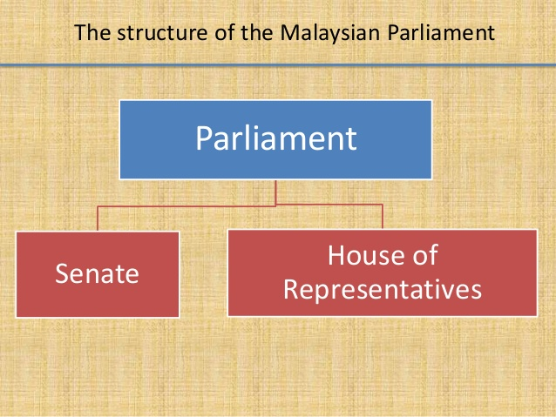

Slide 17
MALAYSIAN PARLIAMENT
Two houses/Bicameral
Dewan Rakyat (House of Representatives)/Lower House
All members are elected through elections
222 members of Parliament (MPs) elected from single-member constituencies
Dewan Negara (Senate)/Upper House
70 members (Senators) – appointment by YDPA (with few criteria)
2 representatives from each state assembly (elected)

Slide 18
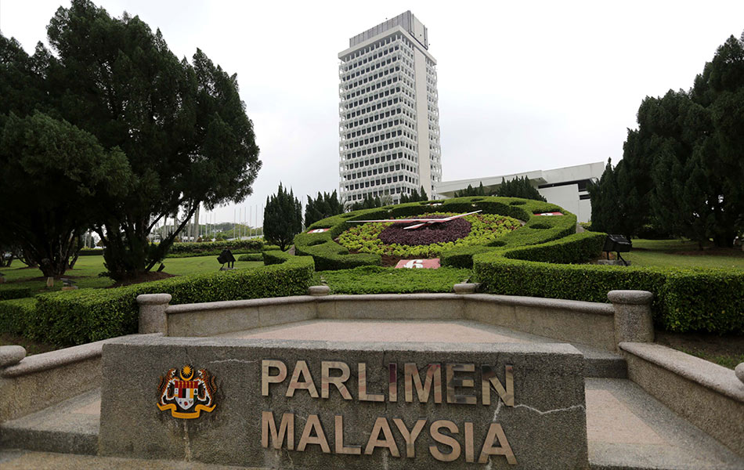

Slide 19
ELECTION IN MALAYSIA
To vote legislative members/people representatives
Election in Malaysia happens at two levels; federal and state level.
Parliament (federal)
Legislative body at Federal level (House of Representatives or Dewan Rakyat)
State assembly (state)
State legislative or Dewan Undangan Negeri ( DUN)
General Election held every 5 years
1956 - The first General Election
2018 – The 14th General Election – important history of political parties in Malaysia – changed the legacy of BN’s rule
People/Voters elect two candidates
Member House of Representatives (Federal level)
Member of State Assembly/DUN (State level)

Slide 20
Members of Dewan Rakyat and Dewan Undangan Negeri are elected from single-member constituencies drawn based on population using the first-past-the post system.
Voting system = simple majority called the first-past-the post system means single choice voting
The single winner is the person with the most votes
In addition to a general election, a by-election may be held when a particular seat in the Dewan Rakyat becomes vacant due to
death of an MP
an MP is disqualified from being a member of the Dewan Rakyat
a seat is declared vacant because the MP has been absent from every sitting of the Dewan Rakyat for a period of six month without leave of the Dewan Rakyat
the members of the Dewan Rakyat have decided to declare the seat vacant
the exception is if the vacancy occurs when the tenure for the current Parliament or state assembly is less than two years, where the seat is simply left vacant until the next general election.

Slide 21
WHO CAN VOTE? (Eligibility to vote)
A voter must register with the EC
Eligibility:
Malaysian citizen
No less than 18 years old on date of eligibility
Resident of any election constituency in Malaysia
Not disqualified
A citizen will disqualified as a voter if
Detained as a person of unsound mind
Serving a sentence in prison
Convicted of an offence and sentenced to death or imprisonment for a term exceeding 12 months and that the person is still serving his/her punishment on the qualifying date

Slide 22
WHO CAN BE A CANDIDATE? (Eligibility to become a candidate)
Must be a Malaysian citizen
A registered voter and resides in a constituency
21 years old and above
Mentally fit
Free from bankruptcy
Cannot hold any position in civil service/not a worker in public services
Not convicted by the courts for any offences of/more 12 months prison and RM2000 fine within the last five years

Slide 23
Election Commission (EC)
An independent and non-aligned body administer the election process in Malaysia
Functions :
regulating and conducting elections in Malaysia.
reviewing the boundaries of parliamentary and state constituencies,
holding by-elections and carrying out registration exercises
collects information on newly developed areas to ensure a fair representation of voters in each constituency,
promotes awareness on how important it is to vote and revise the electoral roll
Establishment under Article 114 of the Constitution of Malaysia.
Falls under the purview of the Prime Minister's Department
7 Members - a chairman, a deputy chairman and five members
Members are appointed by the Yang di-Pertuan Agong after consulting the Conference of Rulers.

Slide 24
THE ELECTION PROCESS

Slide 25
The Dissolution of Parliament
General election will be held every five years. The King or Yang di-Pertuan Agong has the power to dissolve the Parliament.
In this matter, the King has to act on the advice of the Prime Minister to dissolve the Parliament.
After the dissolution of Parliament, an election is required to be held within 60 days in Peninsular of Malaysia or 90 days in Sabah and Sarawak. The same condition applies when the Sultan dissolves the state assembly or when there is a vacant seat.
Writ and notice of election
As soon as Parliament is dissolved, the Election Commission (EC) issues a writ to the returning officers of the various constituencies authorising them to conduct elections in their respective areas.
A notice of election is posted in various places for public viewing. This notice contains the nomination date and the dates for early voting and regular voting.

Slide 26
Nomination of candidate
A date is set for candidates to present nomination papers to the EC officers. For example in GE13, they must do so between 9am and 10am tomorrow.
Each candidate must pay a deposit of RM10,000 for a parliamentary seat or RM5,000 for a state seat. The deposit is confiscated if a candidate fails to garner one eighth of the total number of votes cast in the constituency he is contesting.
EC must ensure candidates are eligible to contest. A candidate is disqualified if he is a bankrupt, is of unsound mind or is not a citizen of Malaysia. If only one candidate is eligible to contest in a constituency, EC will announce his uncontested win.
Any candidate cannot withdraw from his contest once his nomination is accepted.

Slide 27
Campaign period
Begins as soon as the nomination process is complete and ends at midnight before polling day.
A candidate for Parliament may spend a maximum of RM200,000 on campaigning and a state assembly candidates is allowed up to RM100,000.
EC will monitor the conduct of campaigns to ensure that candidates comply with the rules. It can, for instance, remove campaign materials that do not comply with the law and stop illegal forums with police help.
Duration of campaign allow : 7-15 days only
Election campaign
(Insert some pictures on political campaign or poster displays)
Political parties usually use election rally, campaign speech, campaign poster, door to door campaign and social media election campaign.

Slide 28
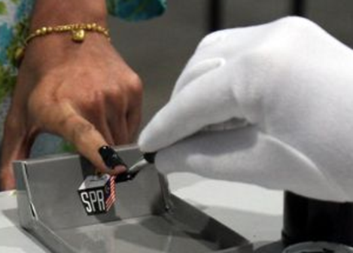

Polling day
Advance polling date will be set for police, military personnel and EC officers. Also to the eligible citizen who stay abroad (officially working and studying abroad).
Usually 2-3 days before the actual polling day.
The ballot boxes will be locked away in secure locations until the regular polling day, when they will be tallied with the regular votes.
Voting hours 8am to 5pm
The voters must present their identity card.
A finger of voters must be marked with indelible ink – to prevent the voters to poll more than once.
The entire process will be observed by election officials and the agents of contesting candidates.

Slide 29
Ballot counting
Once polling closes, the officers in charge will tally the ballots. He will ensure that the number of ballot papers received by the station at the beginning of the day equals the sum of papers given to voters and the number unused.
Ballots with ambiguous and unclear markings will be set aside.
After the other votes are counted, the officers will go through the ambiguous votes to determine if they can be accepted. The ballot/vote will be count based on simple majority (the first-past-the post system)
Forms showing the tally of ballots will be brought to the vote-tallying centre, where the returning officer will announce the result for each polling station.

Slide 30
Announcement of results
The officer of EC for each constituency will declare the winner – usually at the end of the polling day, but may reach until next day.
A coalition or political party who won the election will form the government
Petition
Any candidate who is not satisfied with the announced result can make a petition with Election Court.
Petition can be applied when
Candidates break the election laws/regulation
Candidates are disqualified
There is a violation of election rules/regulations

Slide 31
CONCLUSION
Parliamentary democracy is a kind of democratic form of government
Political parties play a very significant role in parliamentary democracy
Election is an important political activity in parliamentary democracy in Malaysia
Parliament is an important medium between the people and the government.
Parliamentary democracy in Malaysia has been well-practiced since independence.

